Slide 1
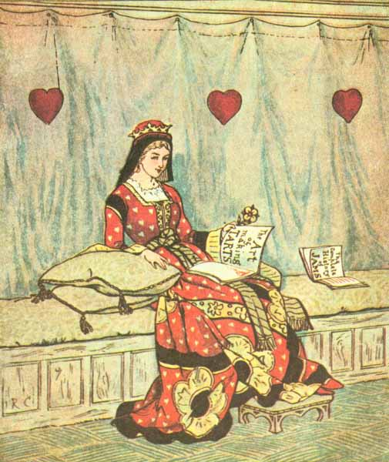
The
Queen
of
Hearts
Notes:
===============
================
The Queen of Hearts
She made some tarts
---------------------------
All on a summer's day
==================
=================
The Knave of Hearts
He stole those tarts
-------------------------------
And took them clean away
====================
=================
The King of Hearts
Called for the tarts
--------------------------------
And beat the knave full sore
=====================
==================
The Knave of Hearts
Brought back the tarts
----------------------------------
And vowed he'd steal no more
=====================
===============

Slide 2
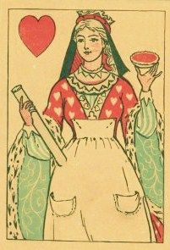
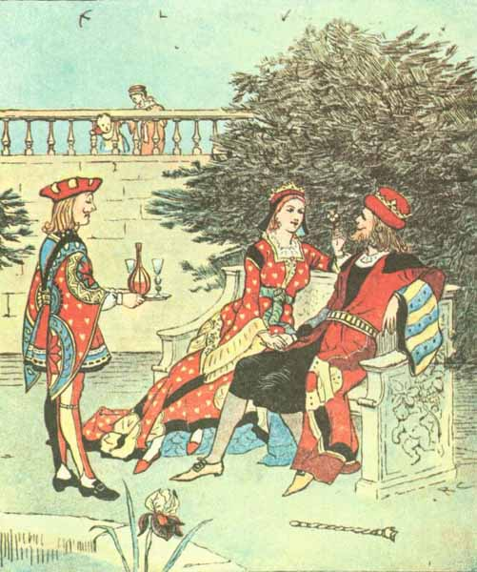
The Queen of Hearts She made some tarts
All on a summer’s day
Notes:
================
The Queen of Hearts
She made some tarts
---------------------------
All on a summer's day
==================
=================
The Knave of Hearts
He stole those tarts
-------------------------------
And took them clean away
====================
=================
The King of Hearts
Called for the tarts
--------------------------------
And beat the knave full sore
=====================
==================
The Knave of Hearts
Brought back the tarts
----------------------------------
And vowed he'd steal no more
=====================
===============

Slide 3
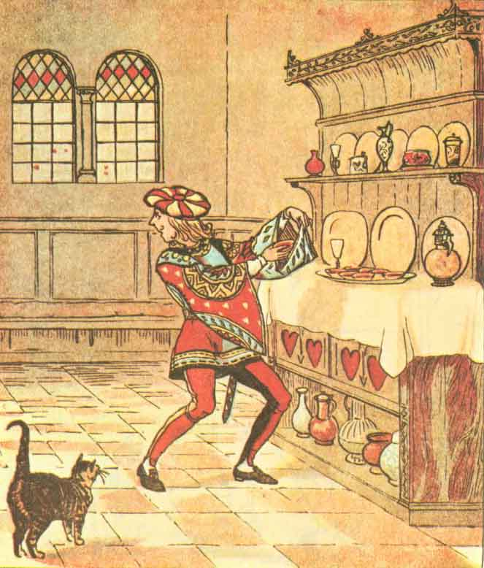
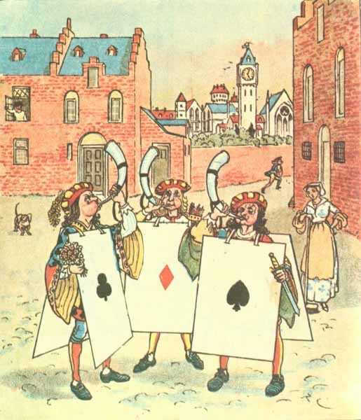
The Knave of Hearts
He stole those tarts
And took them clean away
Notes:
=================
The Knave of Hearts
He stole those tarts
-------------------------------
And took them clean away
====================
=================
The King of Hearts
Called for the tarts
--------------------------------
And beat the knave full sore
=====================
==================
The Knave of Hearts
Brought back the tarts
----------------------------------
And vowed he'd steal no more
=====================
===============

Slide 4
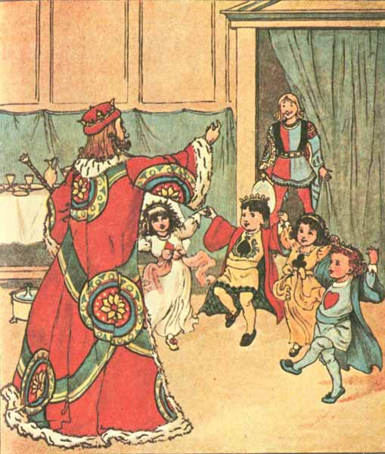
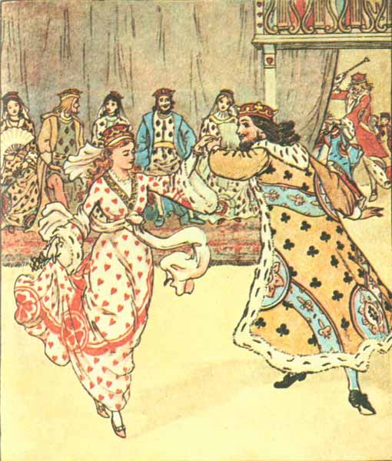
The King of Hearts Called for the tarts
And beat the knave full sore
Notes:
=================
The King of Hearts
Called for the tarts
--------------------------------
And beat the knave full sore
=====================
==================
The Knave of Hearts
Brought back the tarts
----------------------------------
And vowed he'd steal no more
=====================
===============

Slide 5
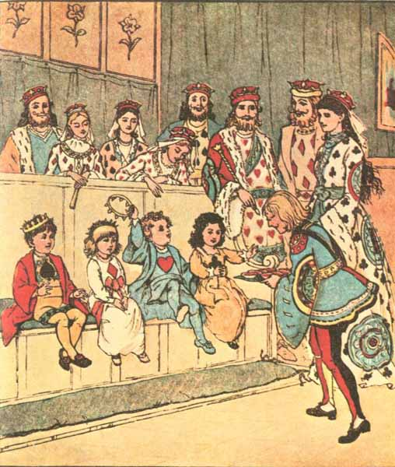
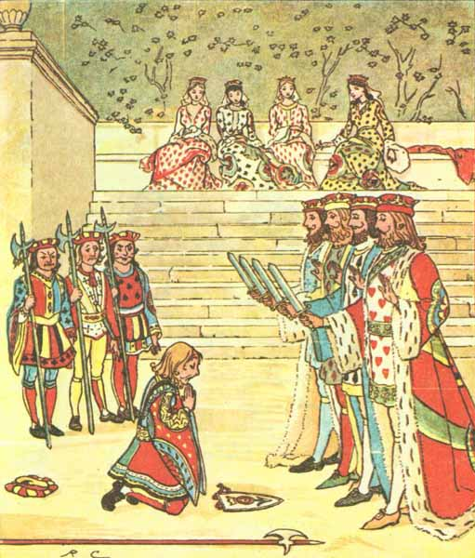
The Knave of Hearts Brought back the tarts,
And vowed he'd steal no more.
Notes:
==================
The Knave of Hearts
Brought back the tarts
----------------------------------
And vowed he'd steal no more
=====================
===============

Slide 6
Thank you for listening.
Greg Conquest
gregconquest.com

